Slide 1


Slide 2

Who is HEJ ?

Slide 3
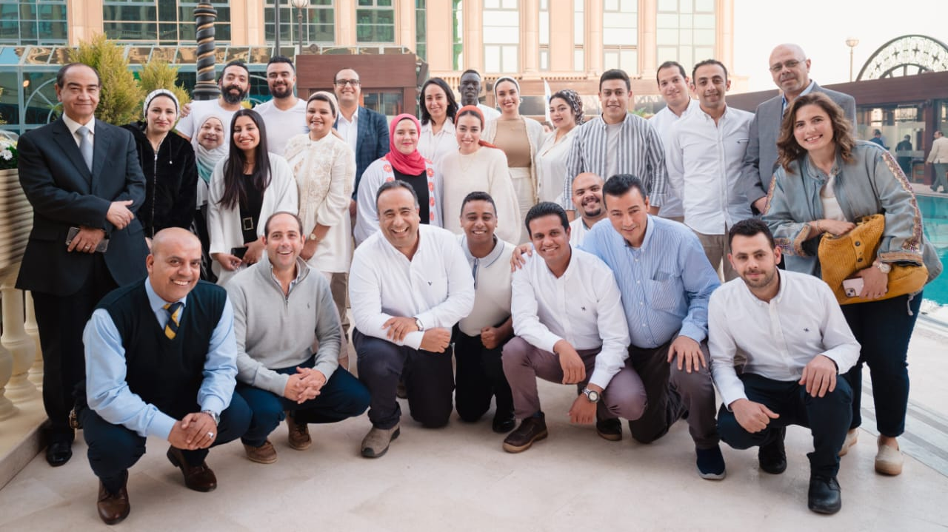
Our Team

Slide 4
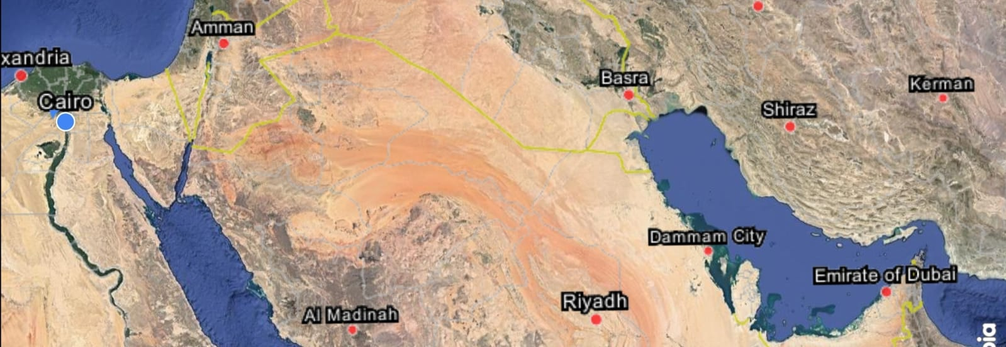
We are a regional destination management company specializing in Egypt, Jordan, and Dubai.

Slide 5
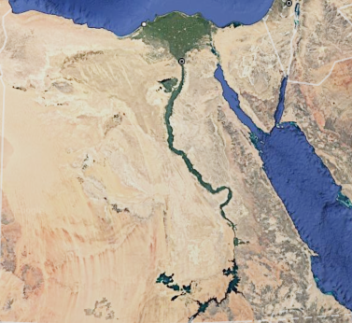
Our team is fully comprised of Egyptians, proudly born and raised in Egypt, which gives us a rich and authentic Egyptian background.
As a midsize luxury company, we emphasize quality and exclusivity over mass production.
We offer a wide array of unique, off-the-beaten-path experiences that you won’t find elsewhere.
Our focus is on providing genuine, authentic experiences rather than commercialized offerings.
Rather than imposing Western culture, we tailor the beauty of Egyptian culture to resonate with Western travelers.
We are committed to fostering meaningful connections between people.

Slide 6
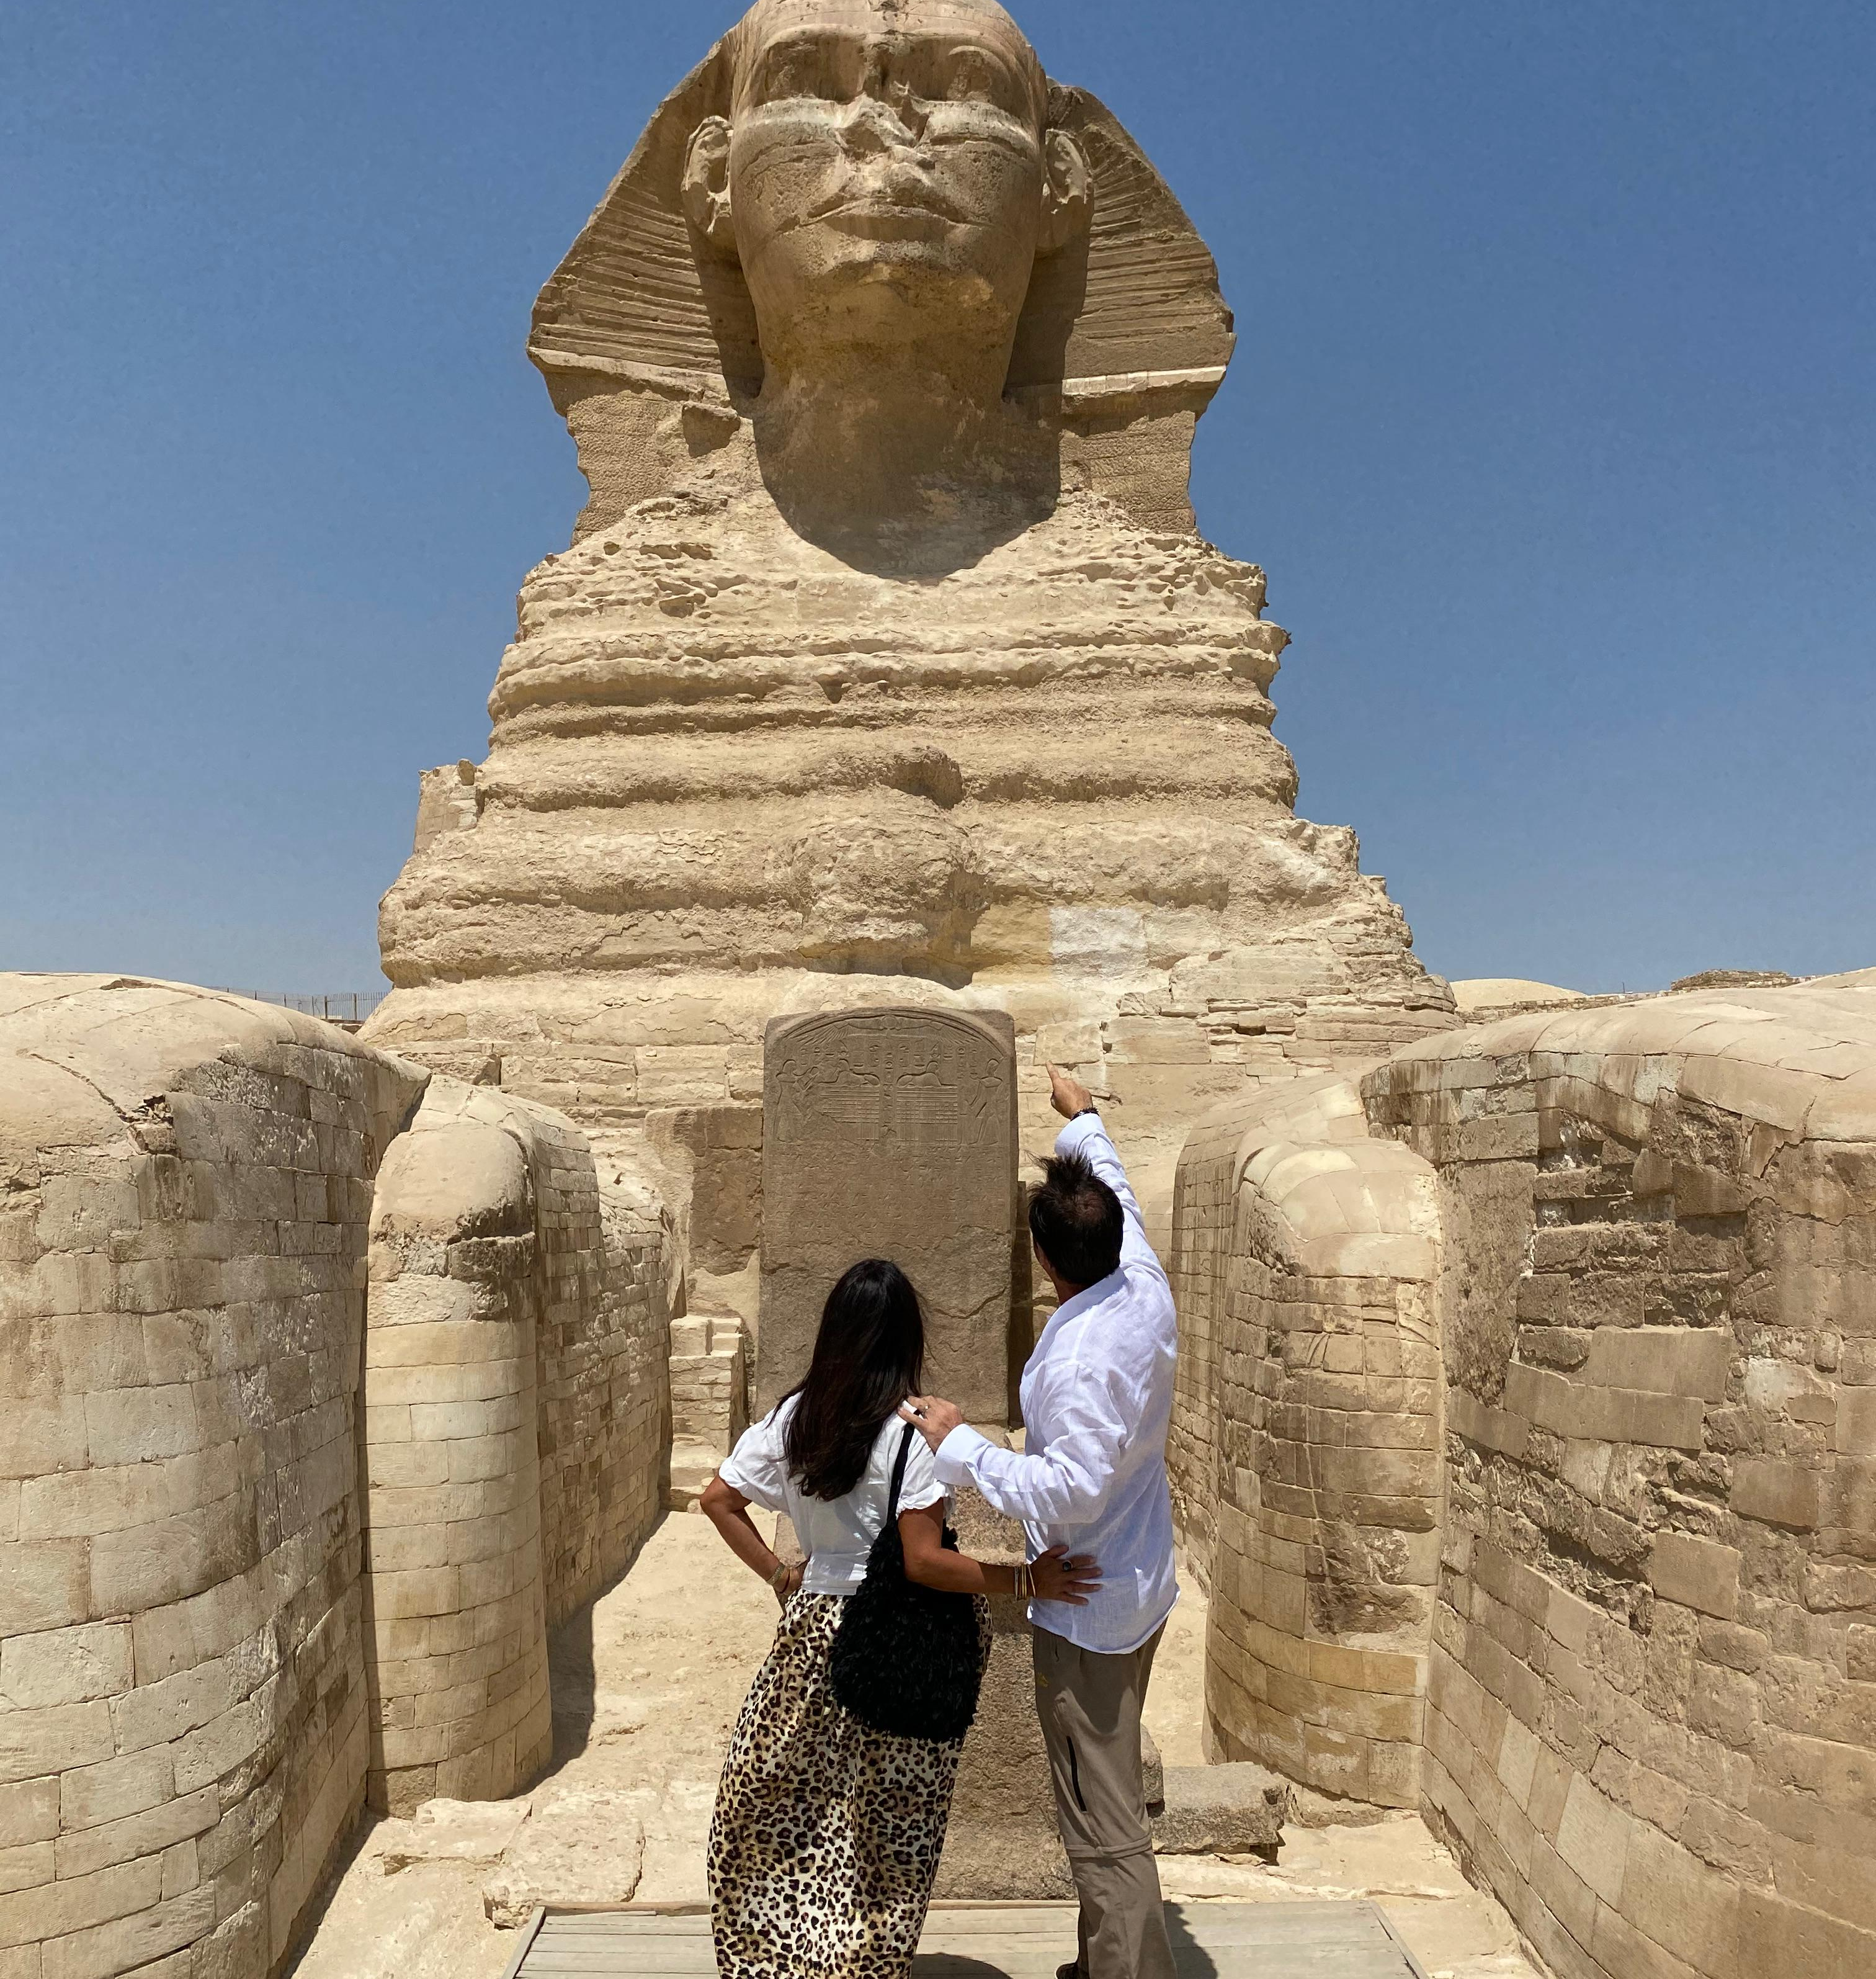
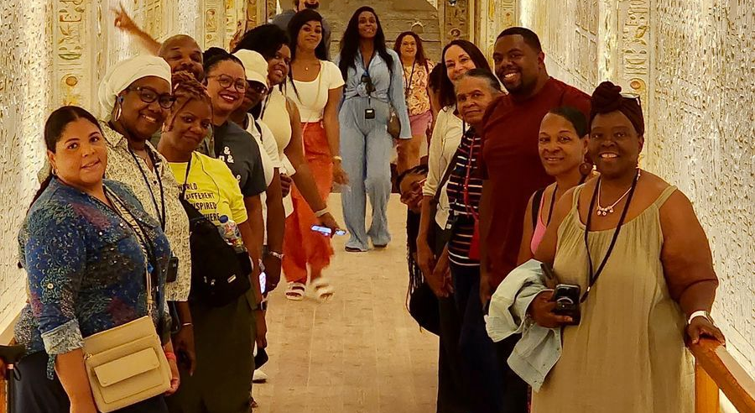
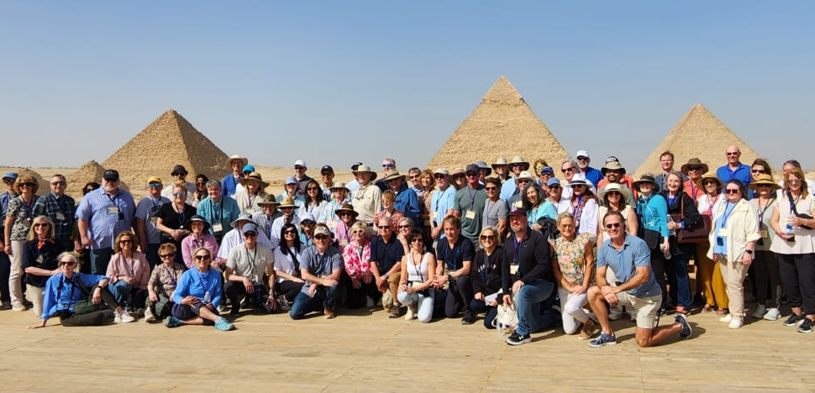

Slide 7
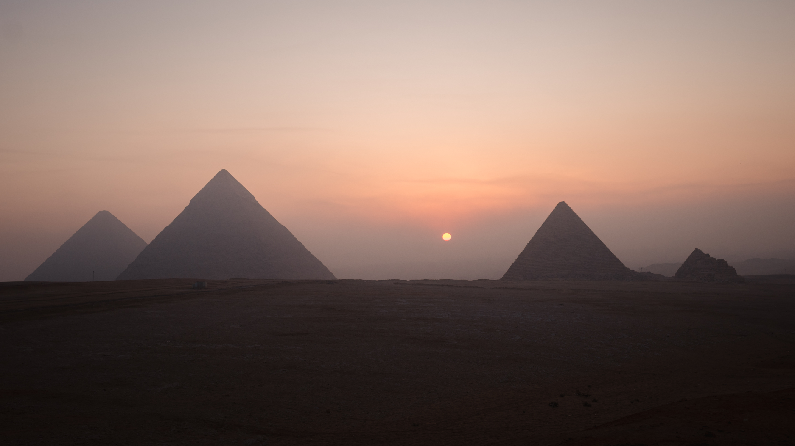
Insider Access Experiences

Slide 8
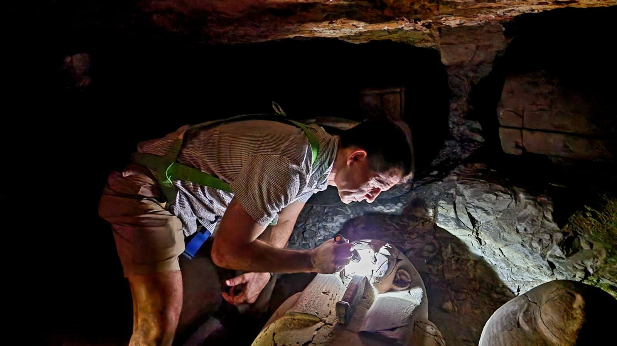
Access to an Active Archeological Site

Slide 9


Slide 10
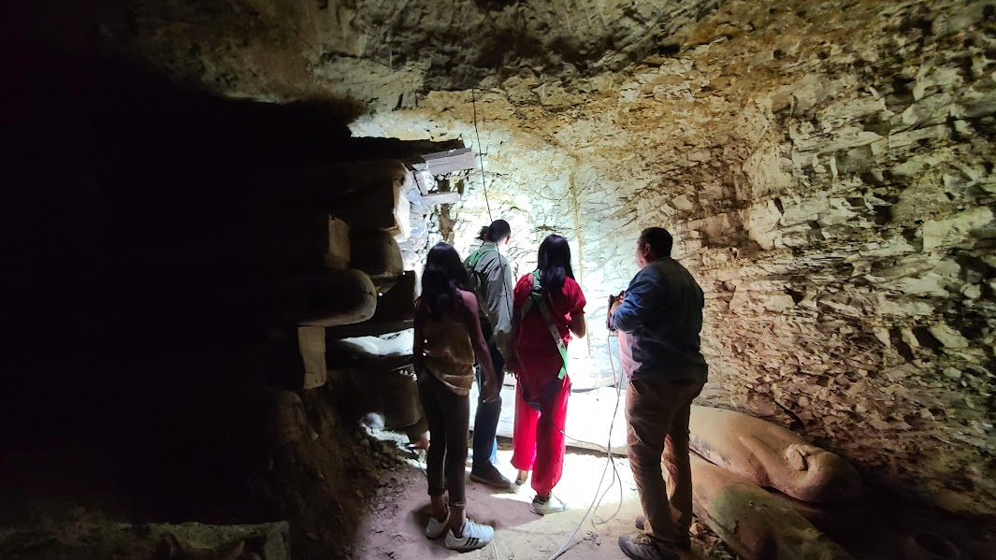

Slide 11
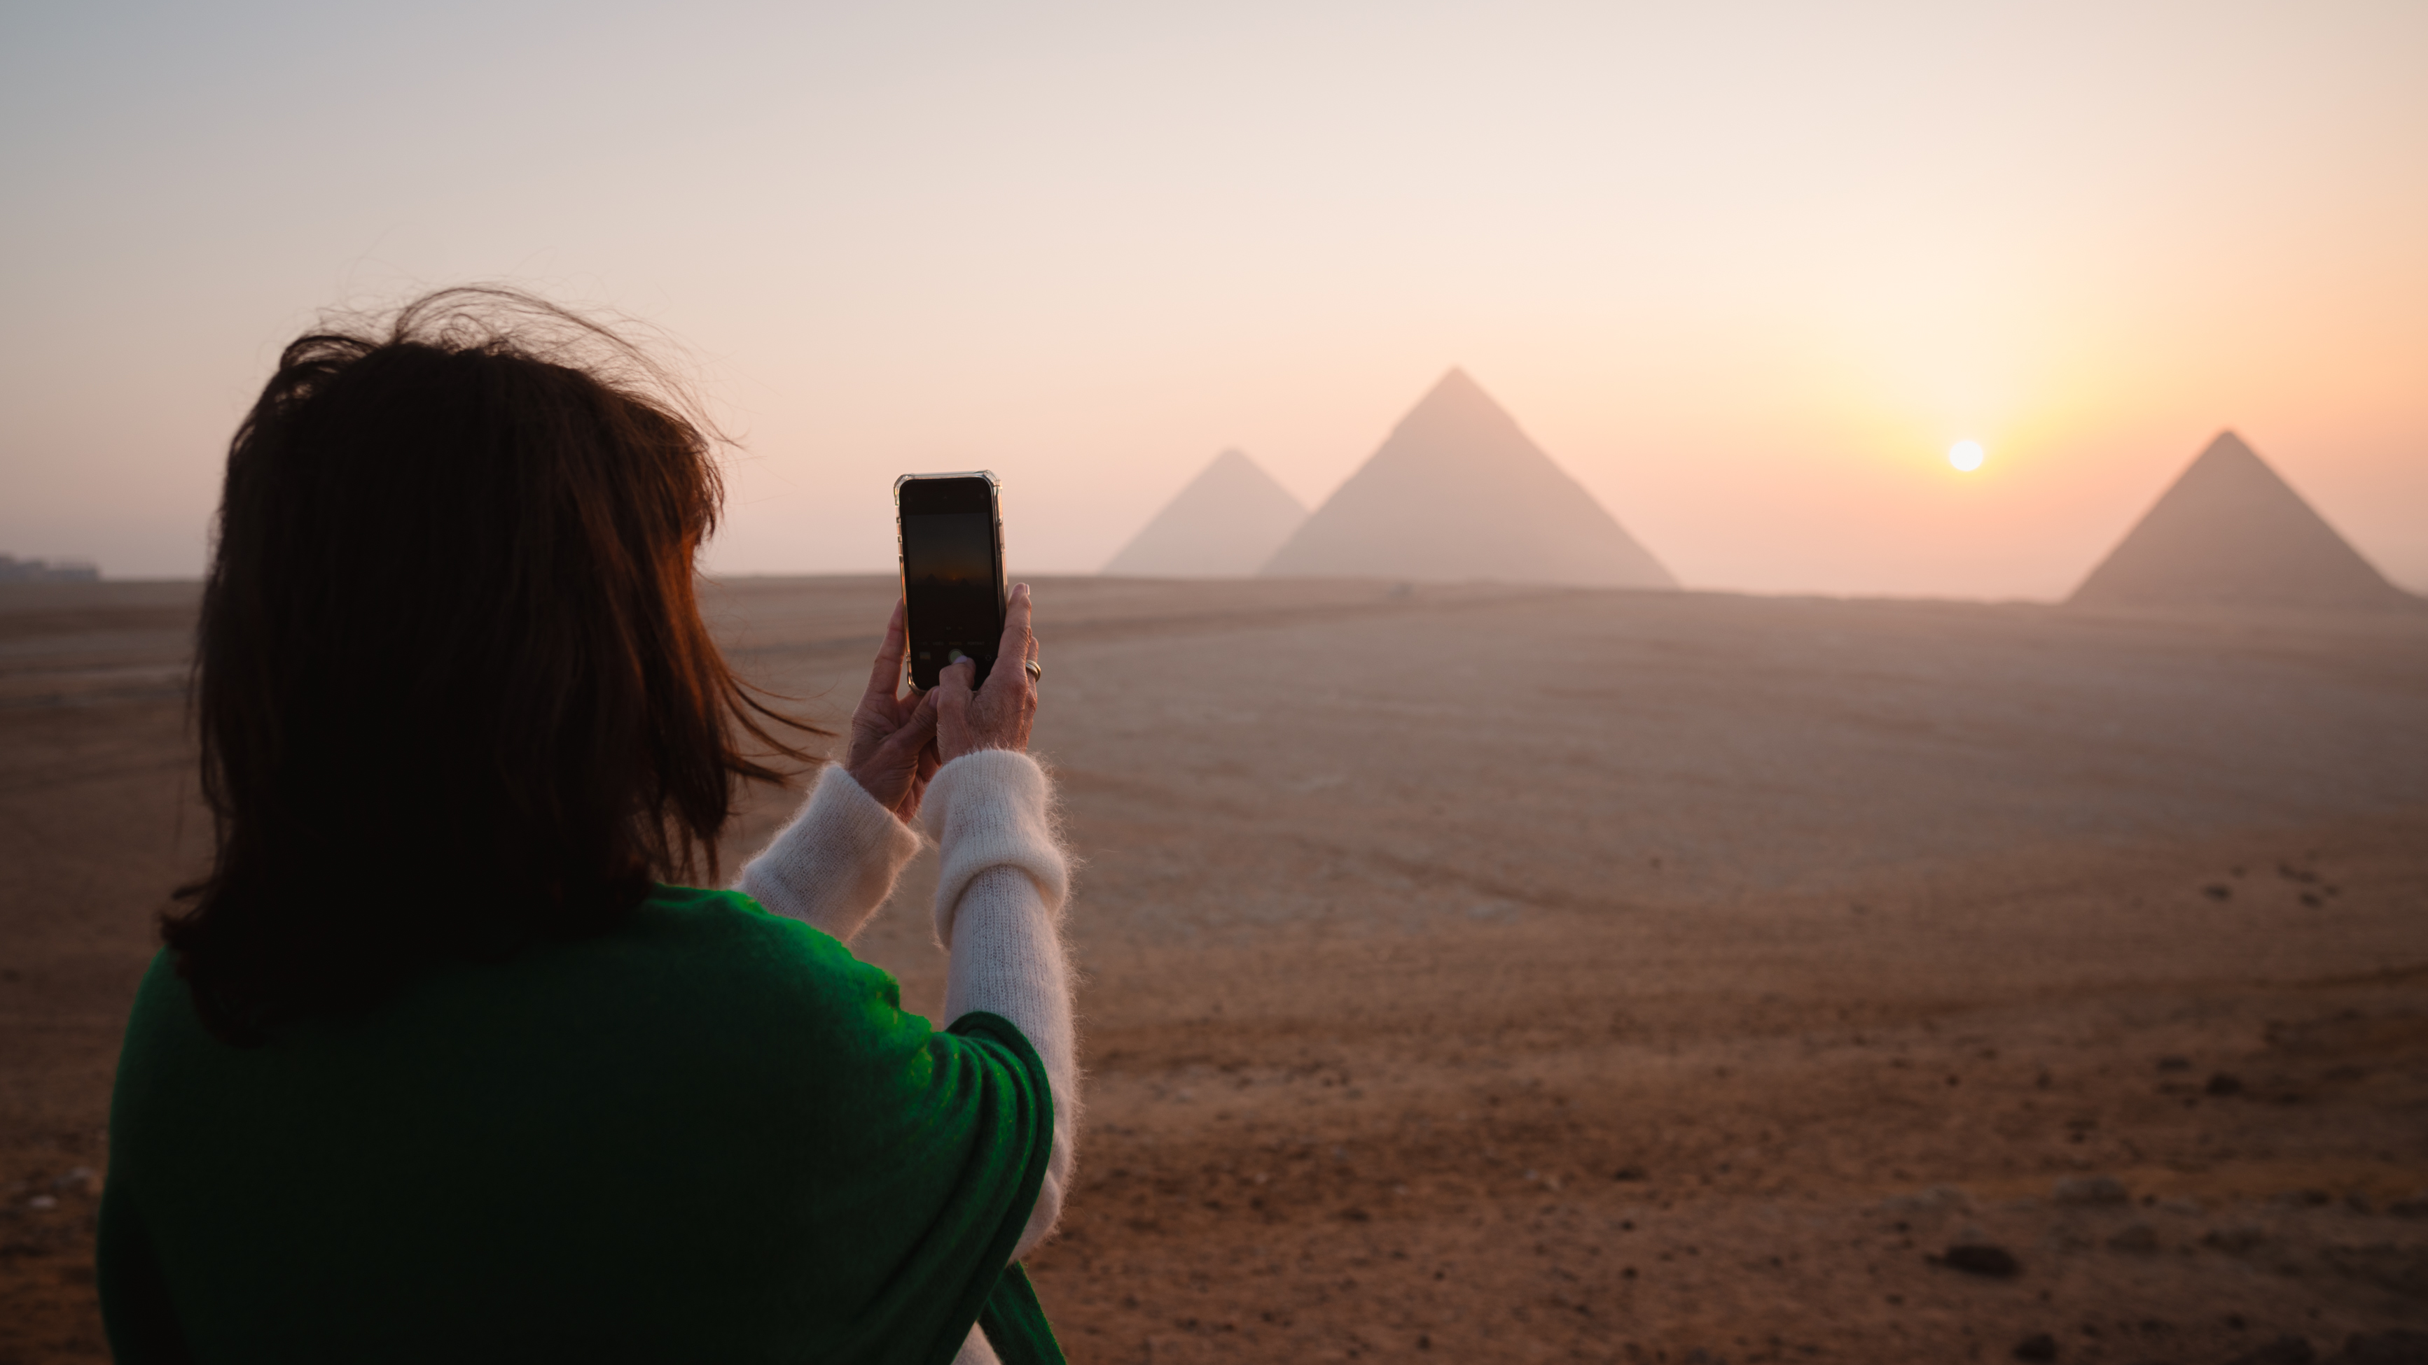
Private Access to the Pyramids of Giza

Slide 12


Slide 13
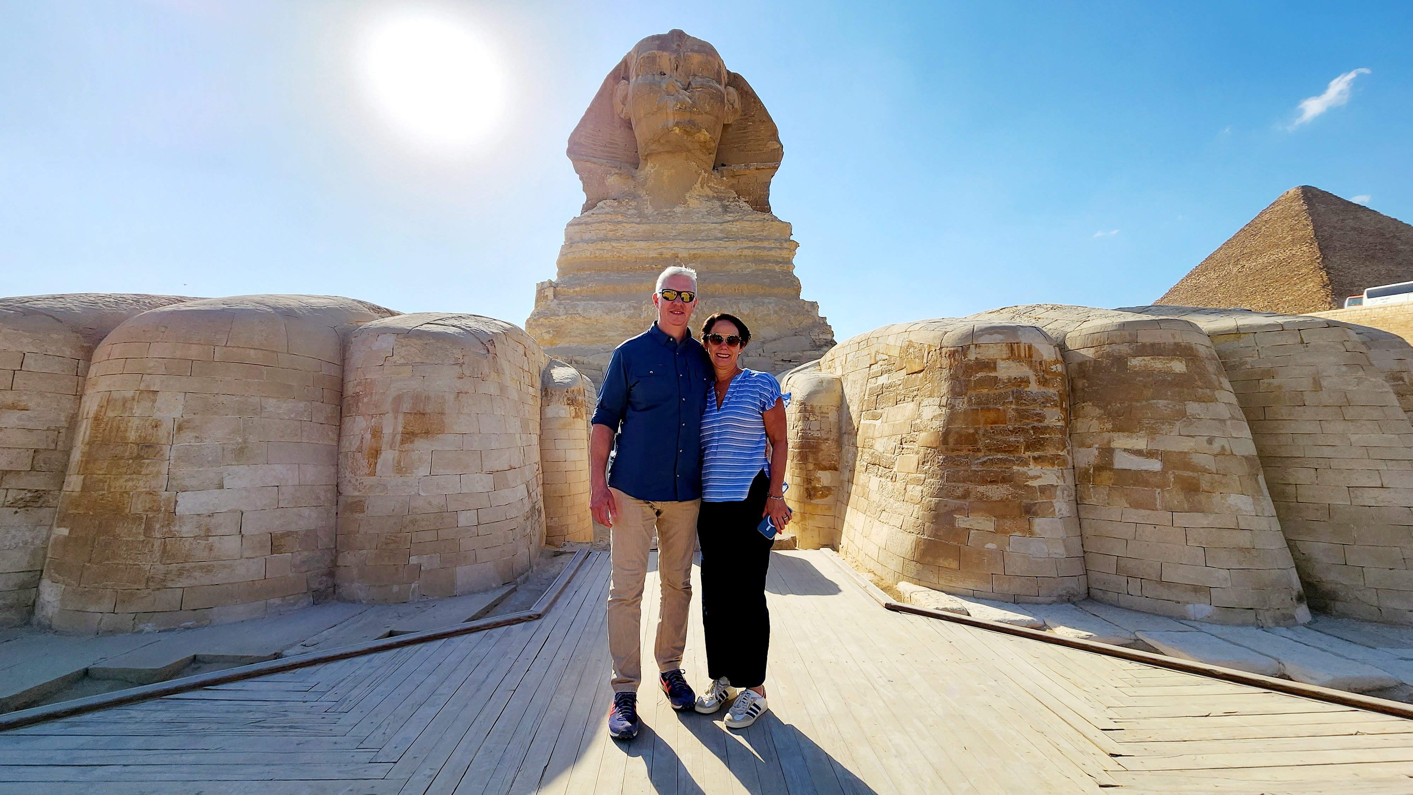
Access to the Paws of the Sphinx

Slide 14
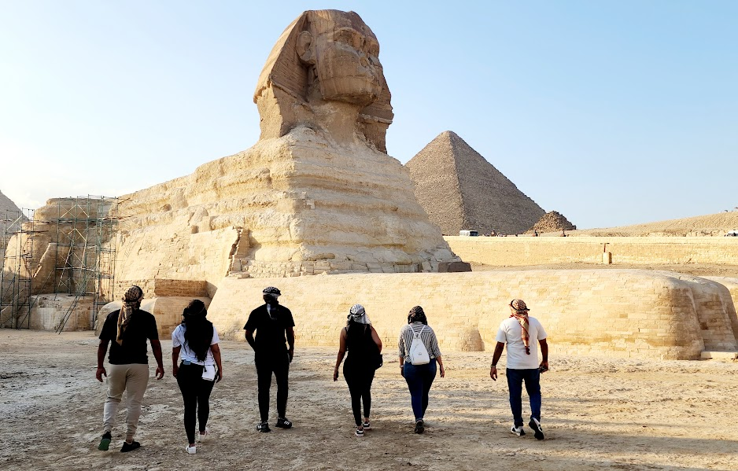

Slide 15
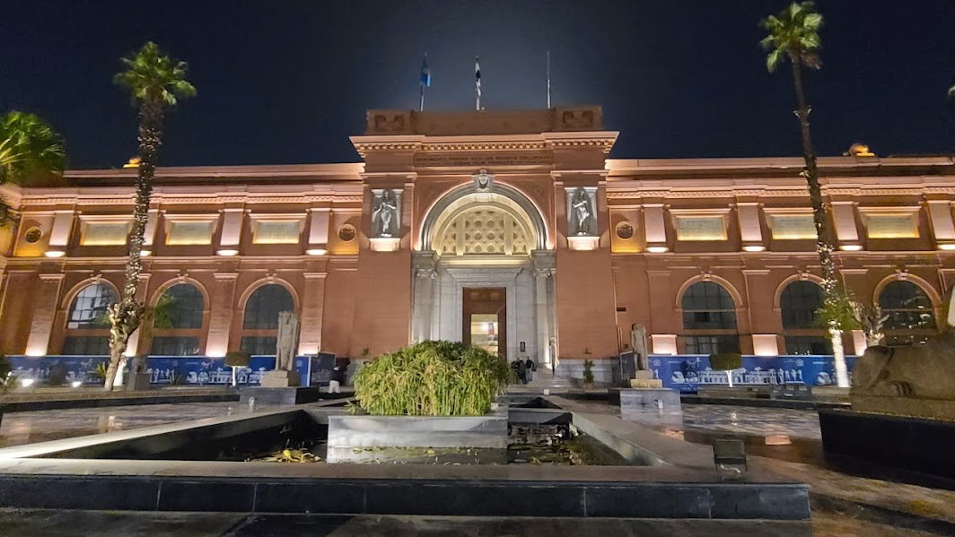
Access to the Egyptian Museum

Slide 16
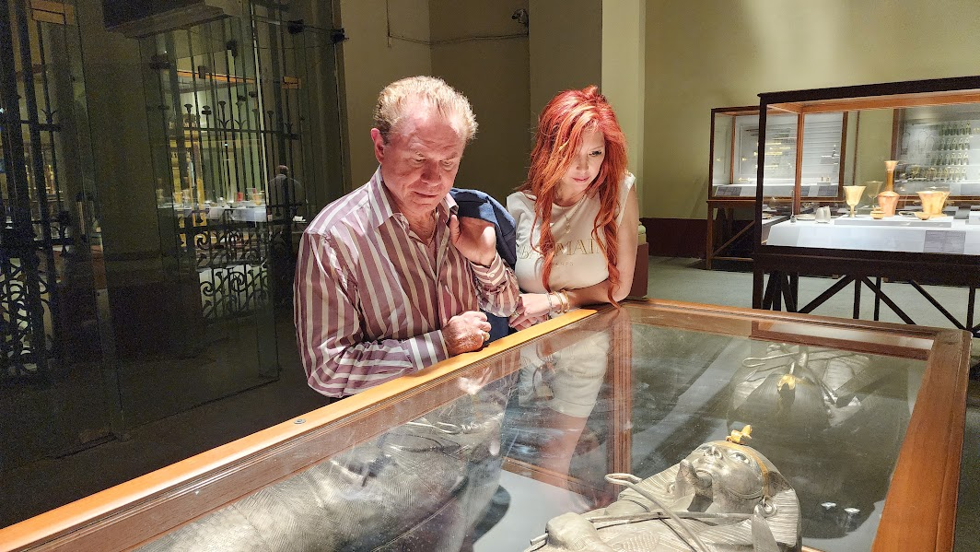

Slide 17
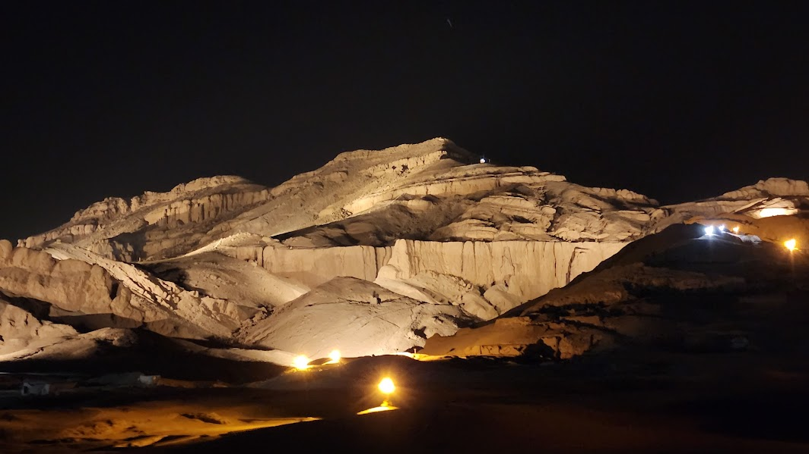
Private Access to Archeological sites at Night

Slide 18
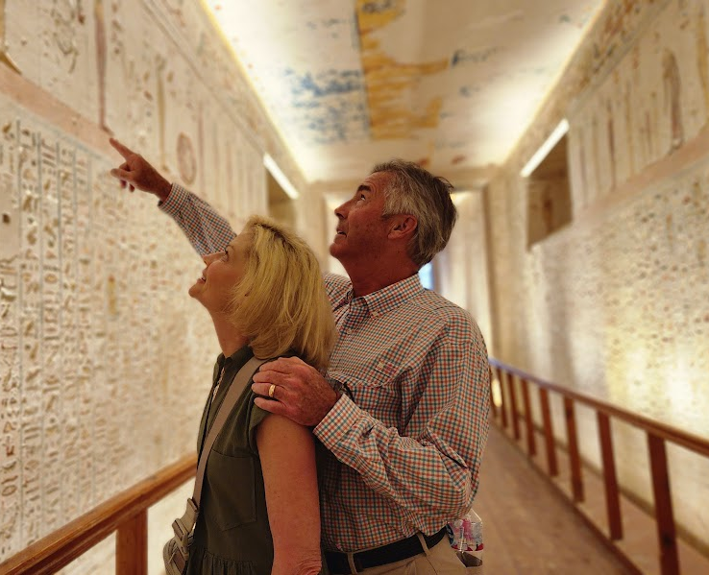
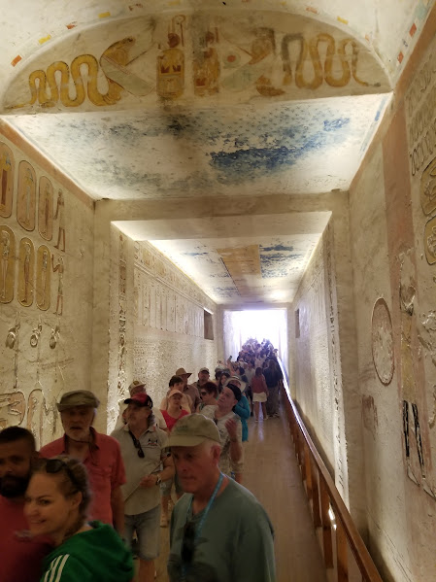

Slide 19
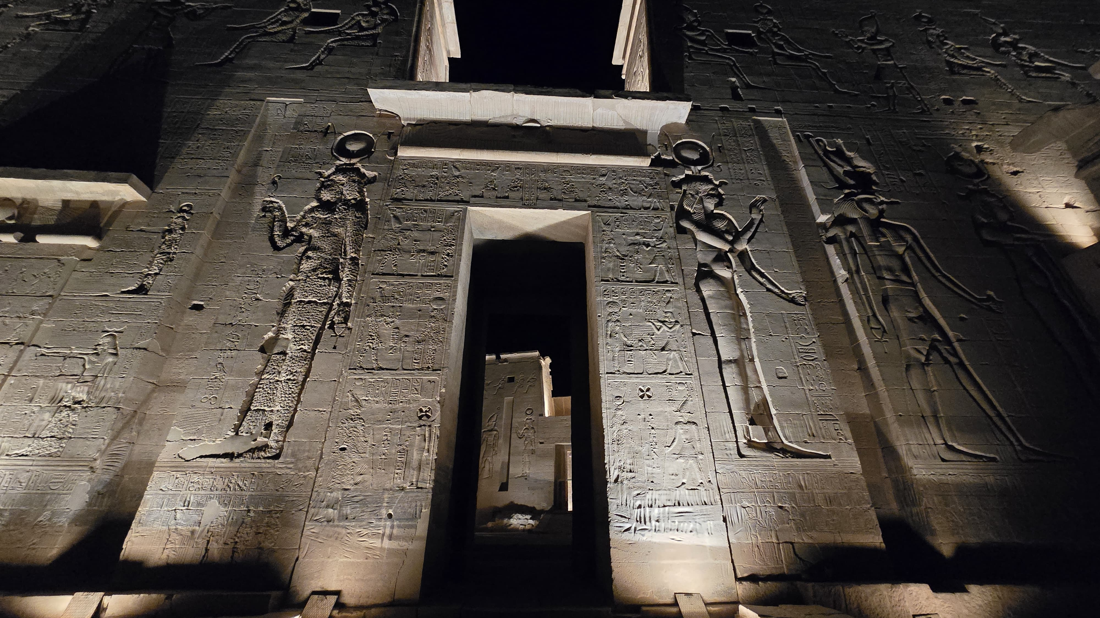

Slide 20

Helicopter Ride Over the Pyramids

Slide 21
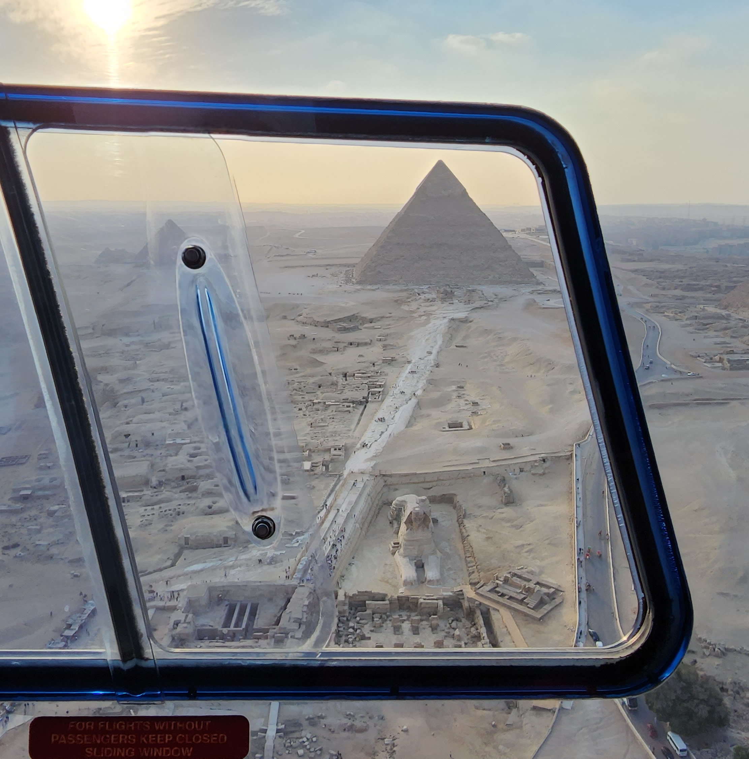
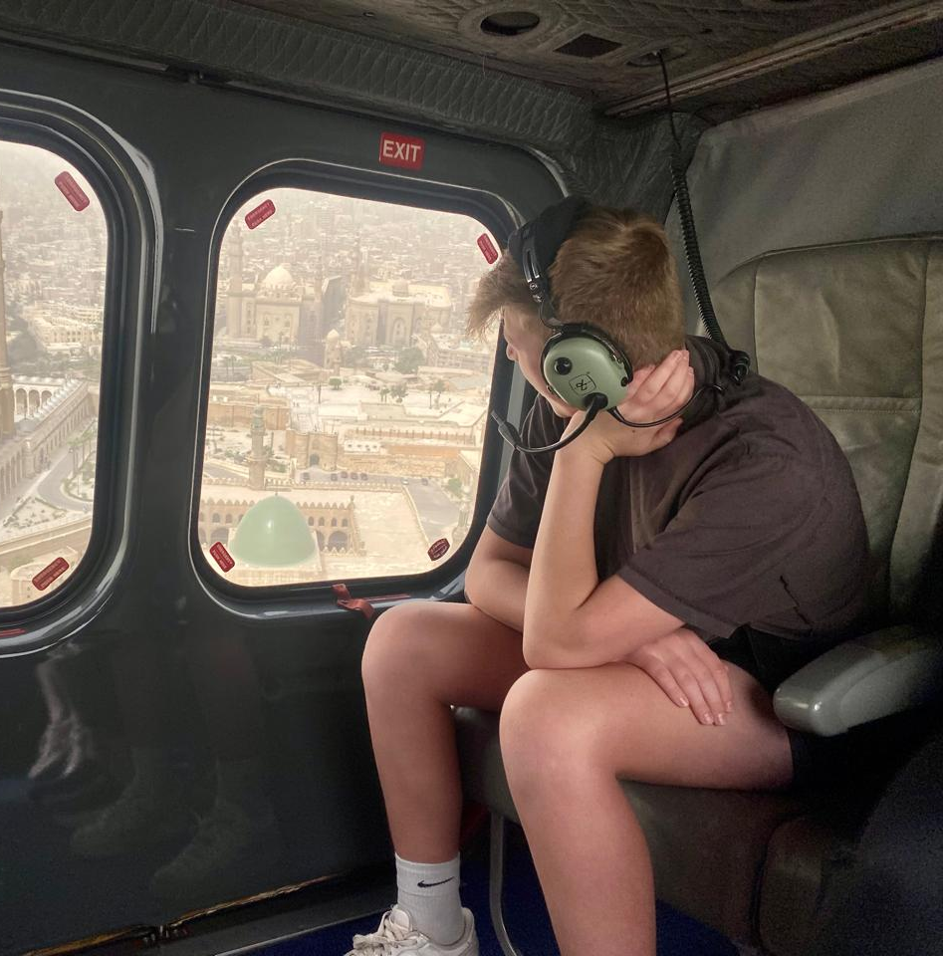

Slide 22

Authentic Experiences

Slide 23


Slide 24
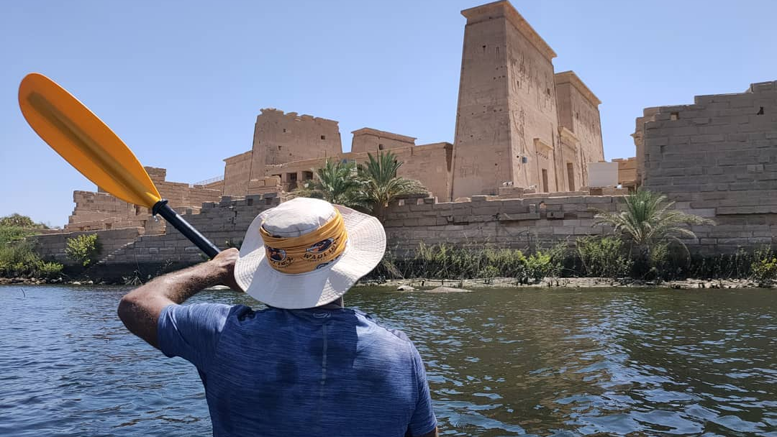
Kayaking on the Nile

Slide 25
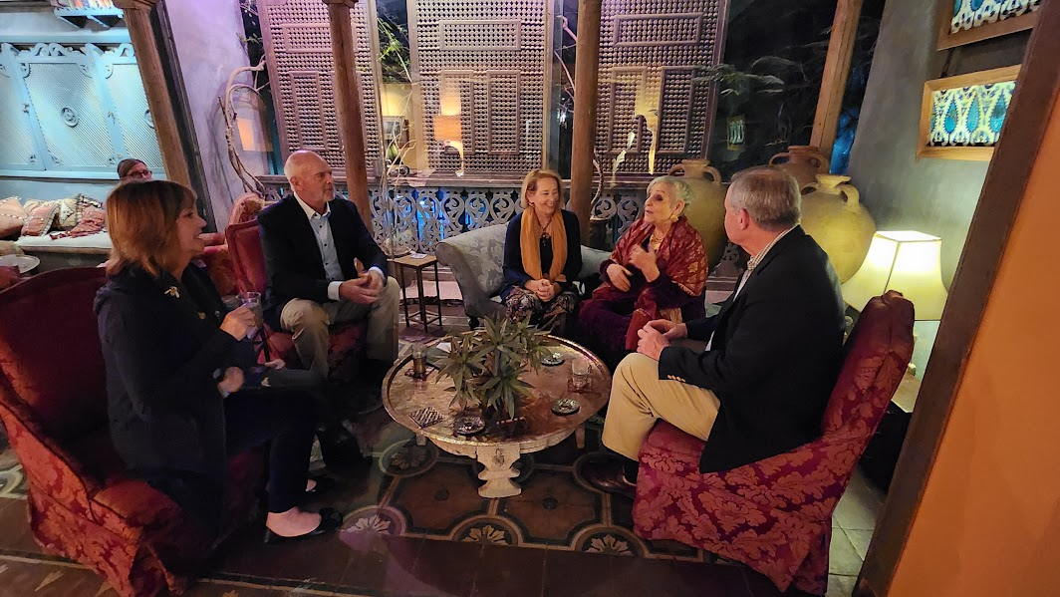
Family Hosted Dinners

Slide 26

Cooking Classes

Slide 27
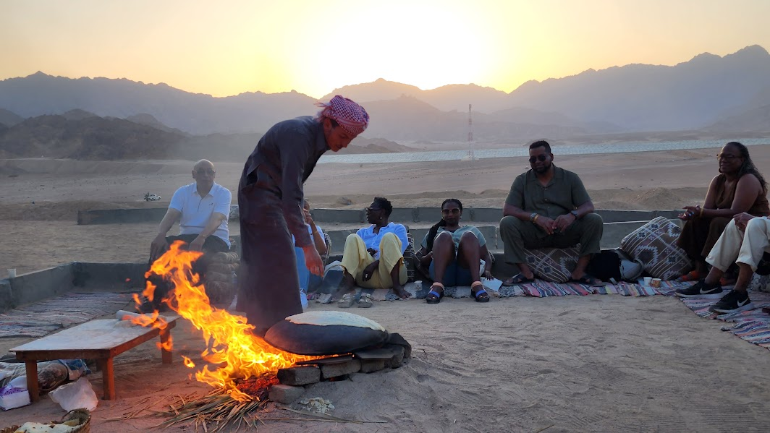
Bedouin Dinners

Slide 28

Desert Safaris

Slide 29
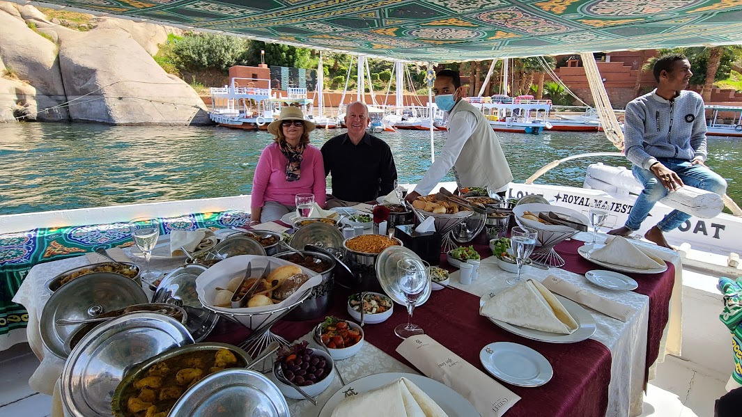
Legendary Felucca Lunches

Slide 30

Ultra Luxury Experiences

Slide 31
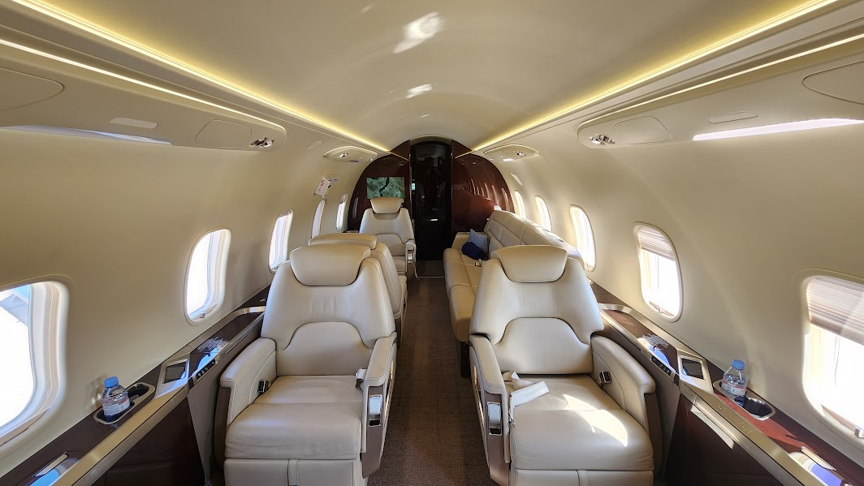
Chartering Private Jet

Slide 32
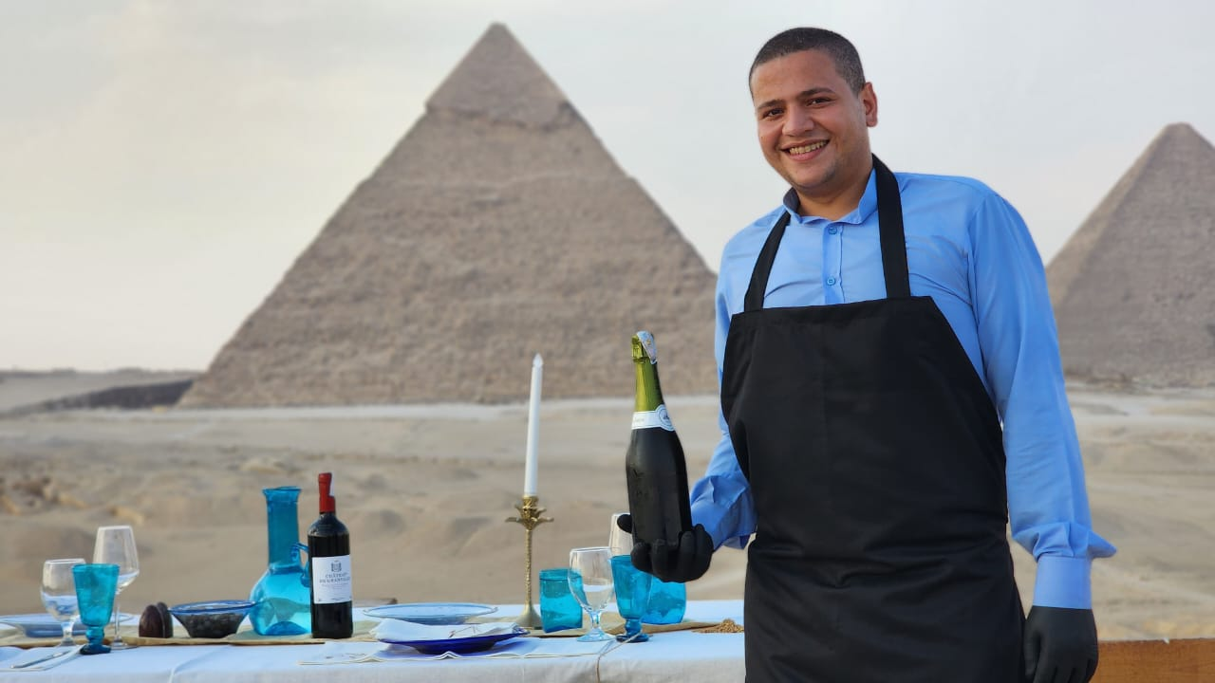
Private Dinner overlooking the Pyramids

Slide 33
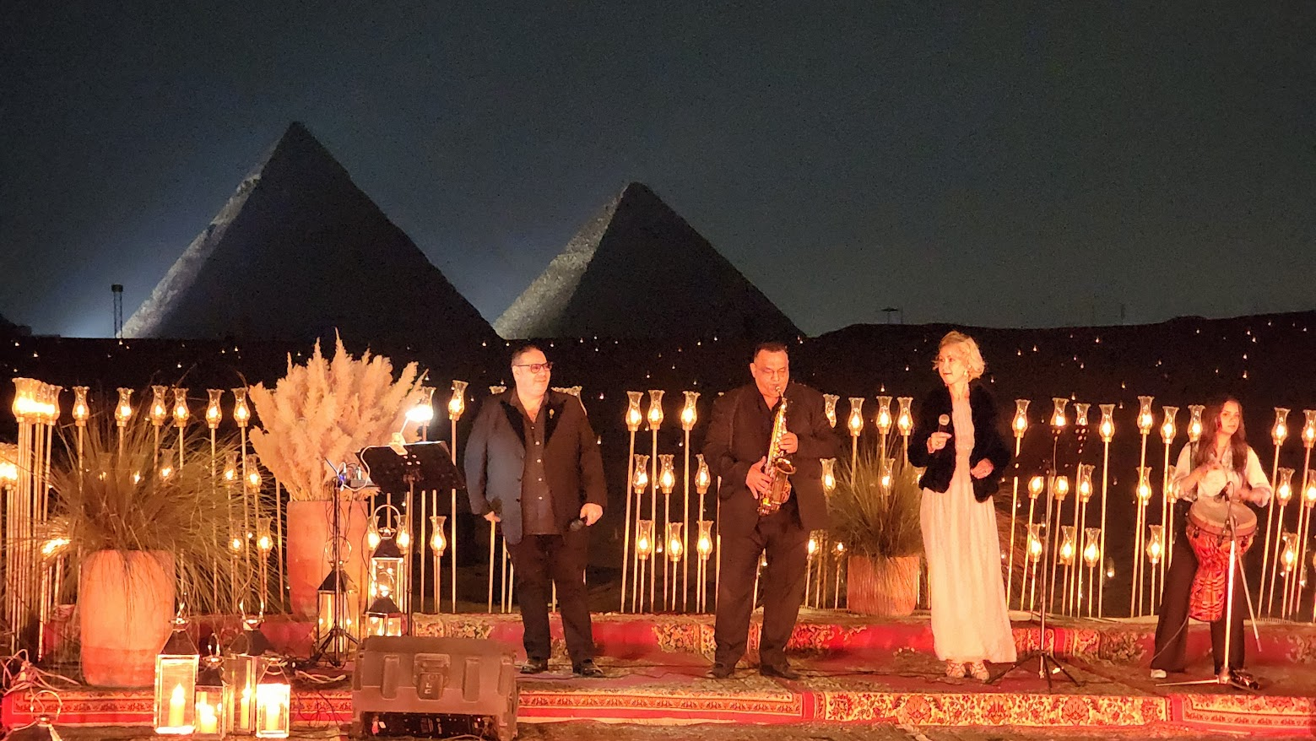

Slide 34
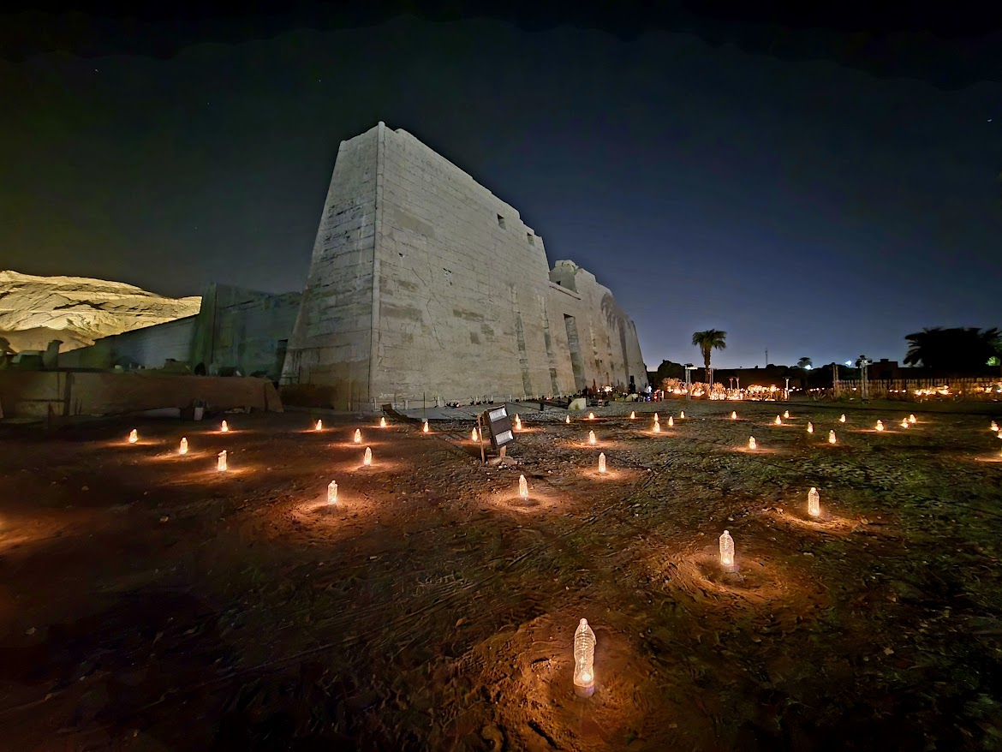
Private Dinner at the Temples

Slide 35
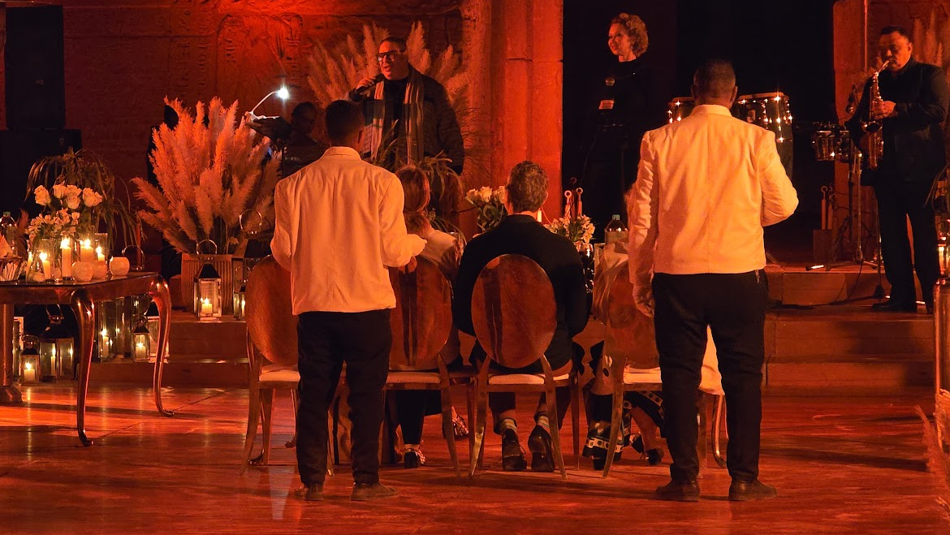

Slide 36
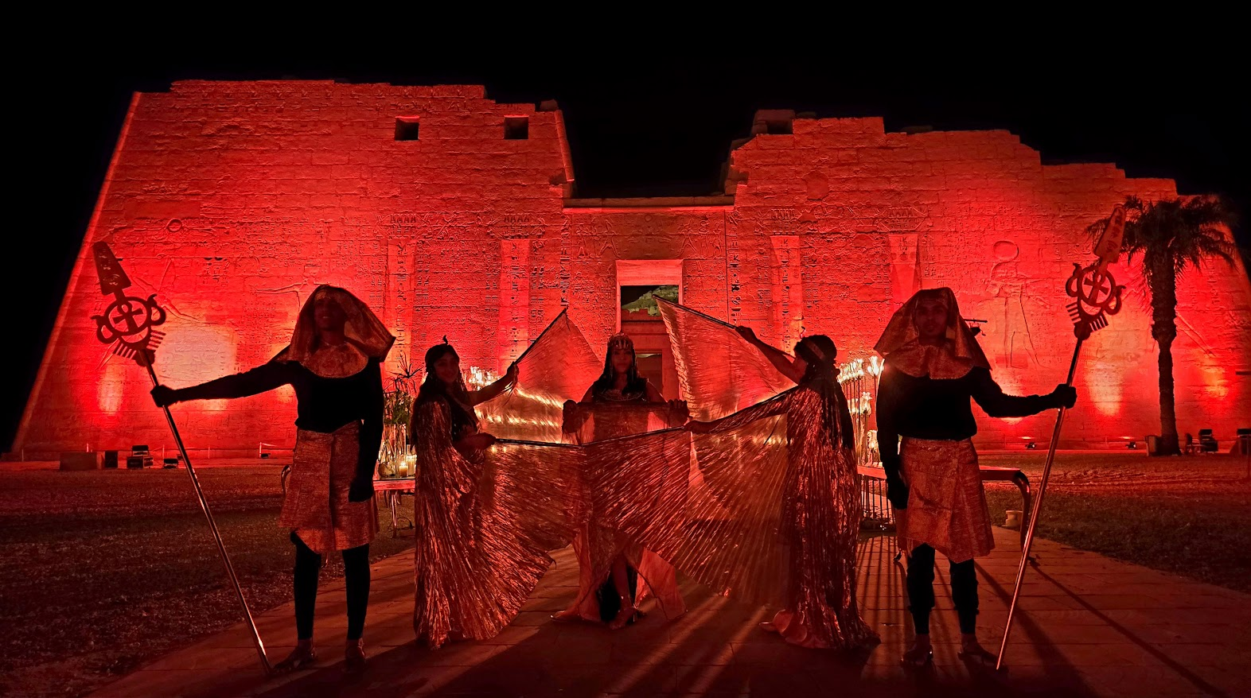

Slide 37
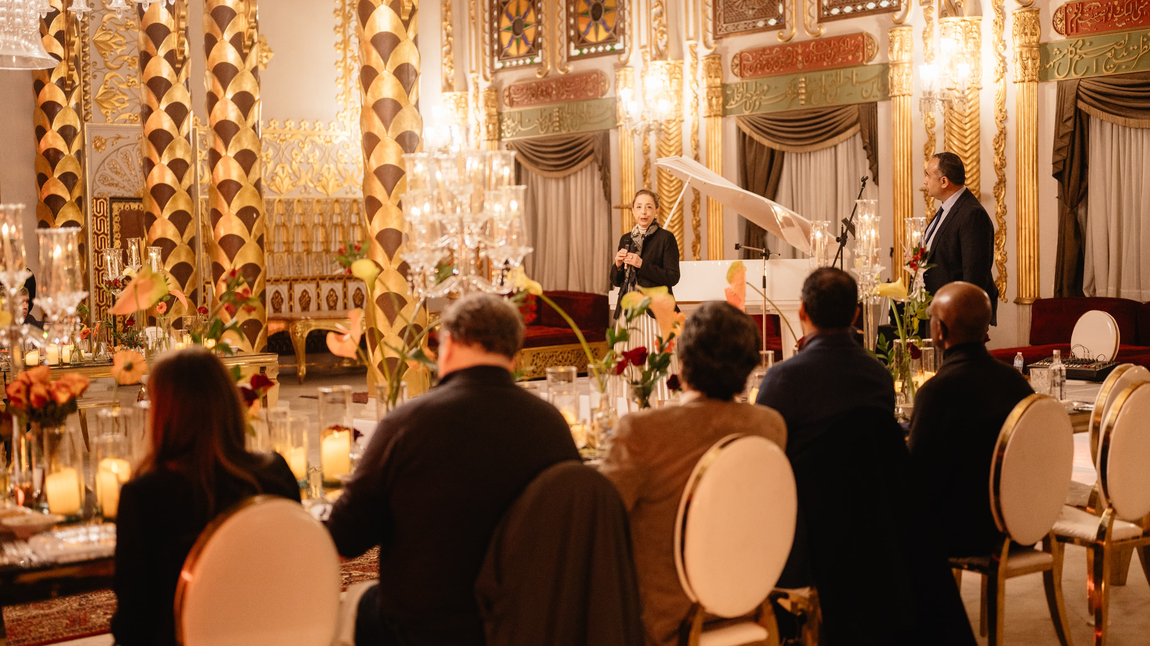
Private Dinners at Palaces

Slide 38
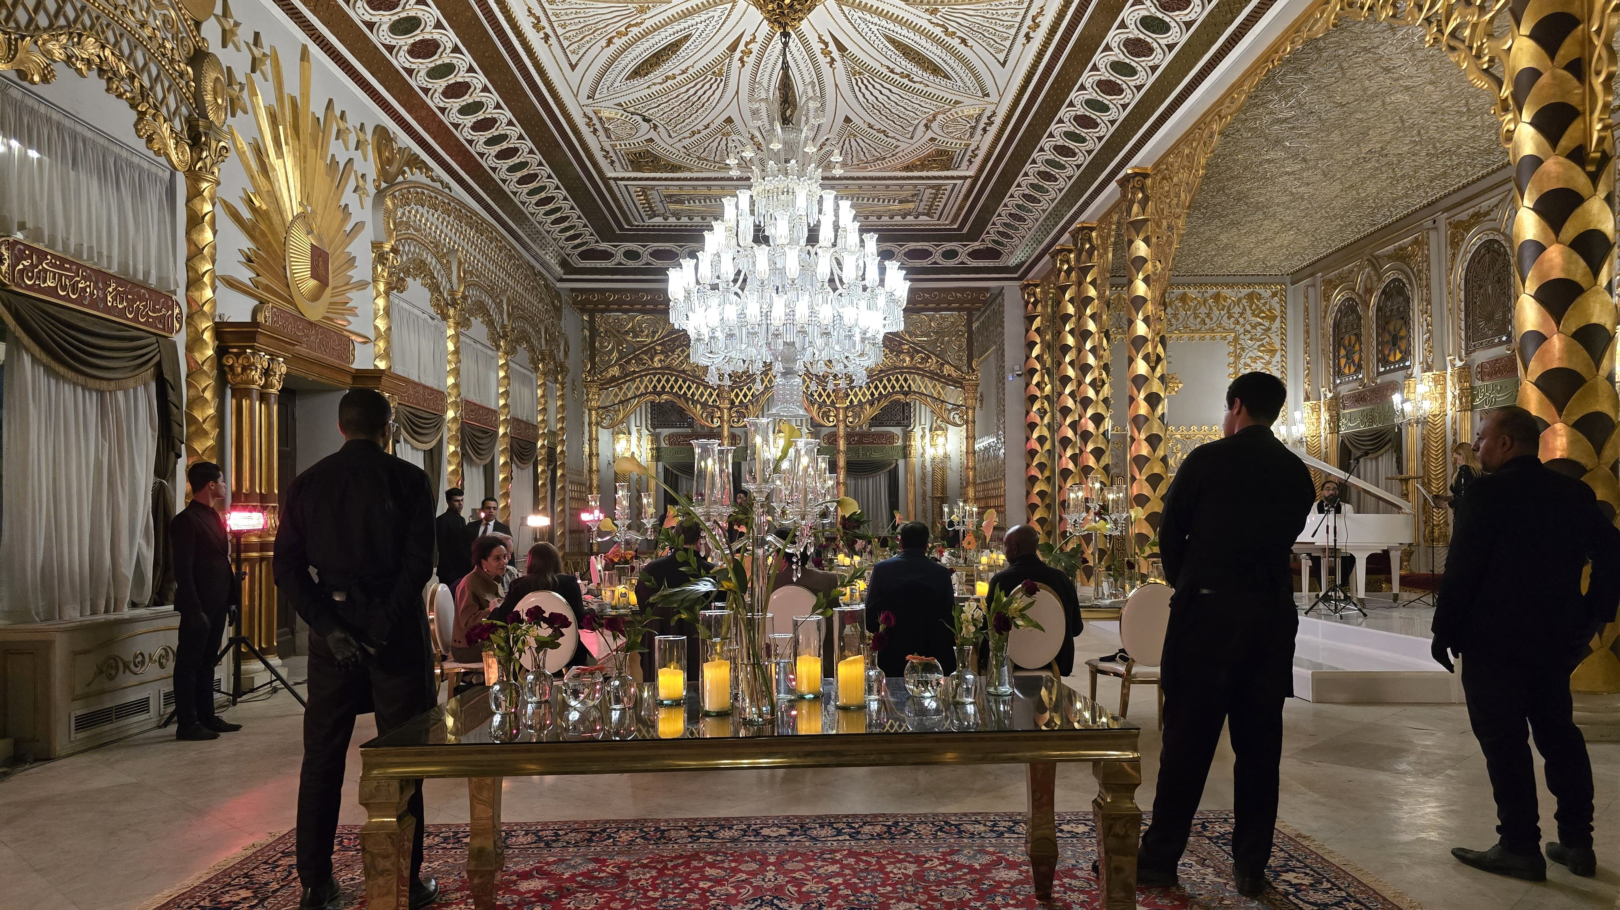

Slide 39
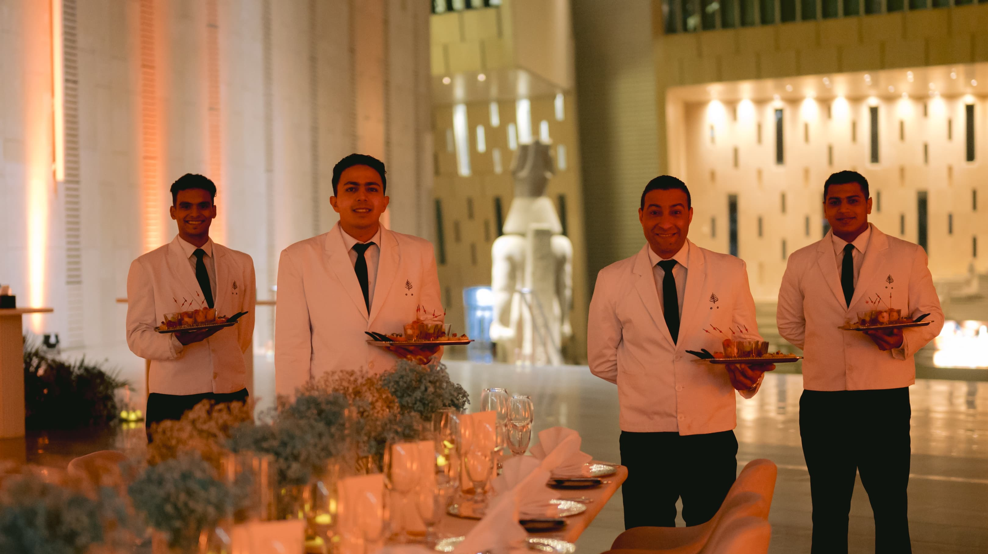
Private Dinners at Museums

Slide 40


Slide 41
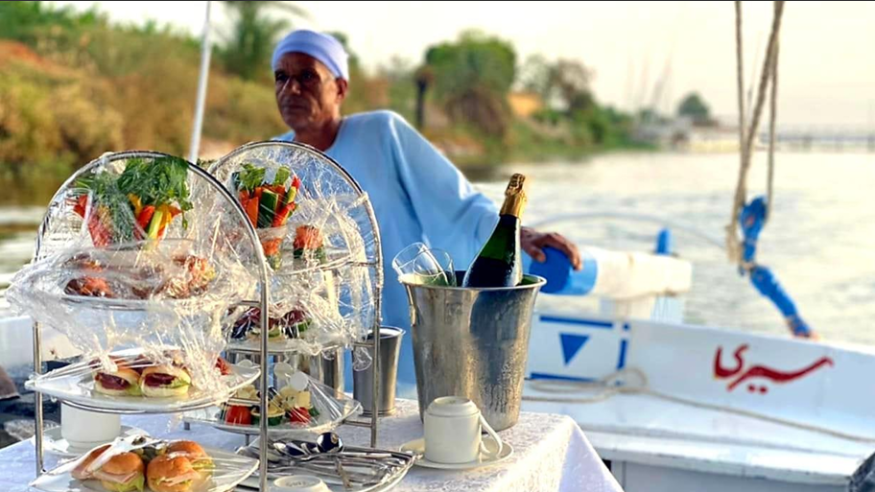
Champagne Felucca Breakfast

Slide 42
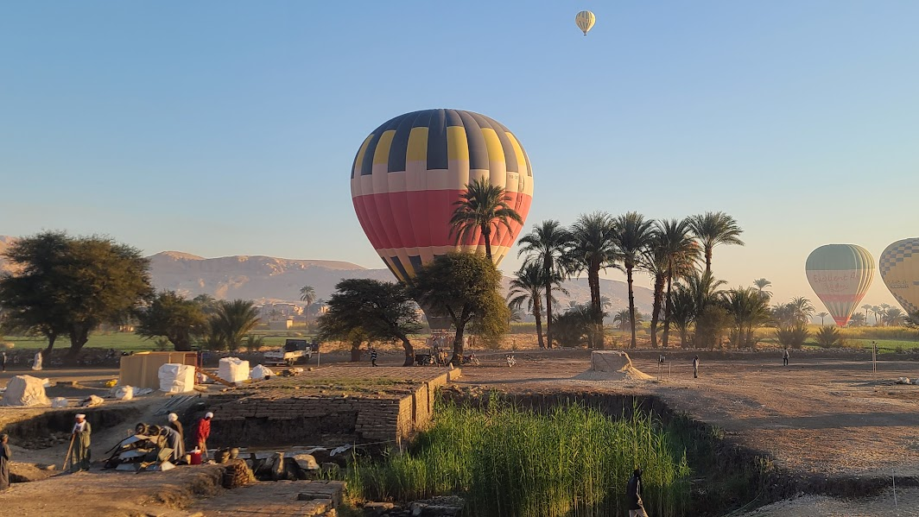
Private Hot air Balloon

Slide 43

Meeting with Iconic figures Politicians and Archeologists

Slide 44
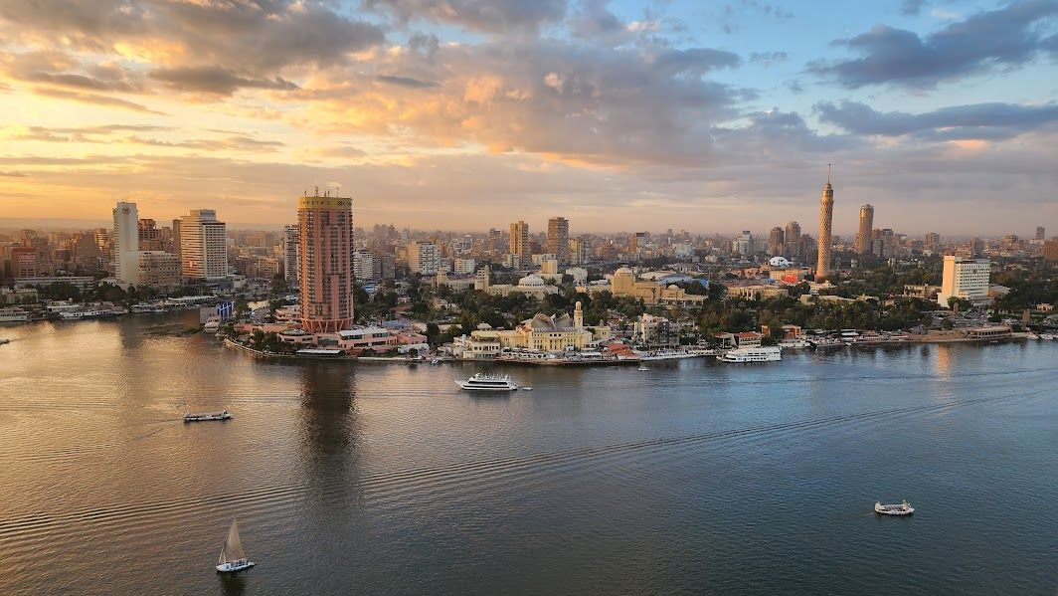
Accommodations

Slide 45
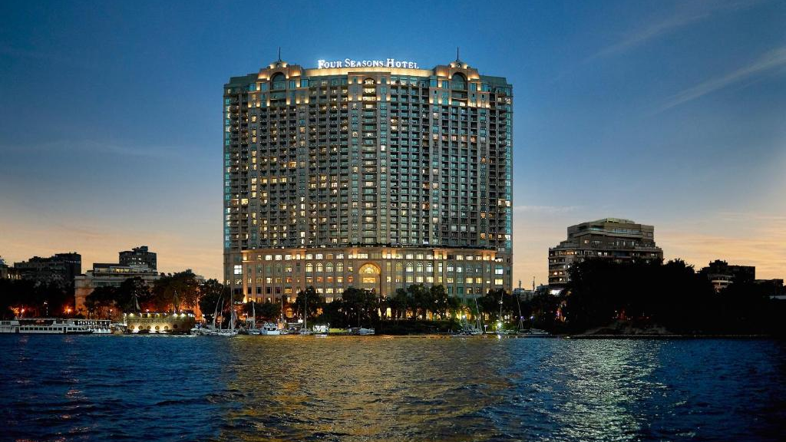
Luxury Hotels

Slide 46
Four Seasons at Nile Plaza

Slide 47
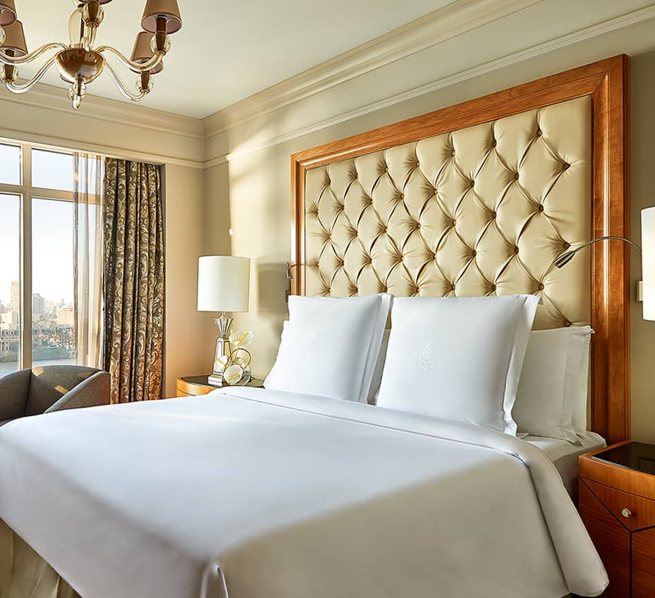
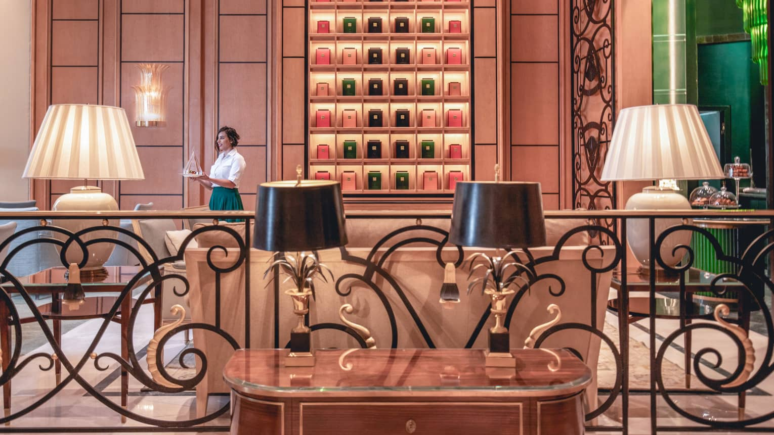
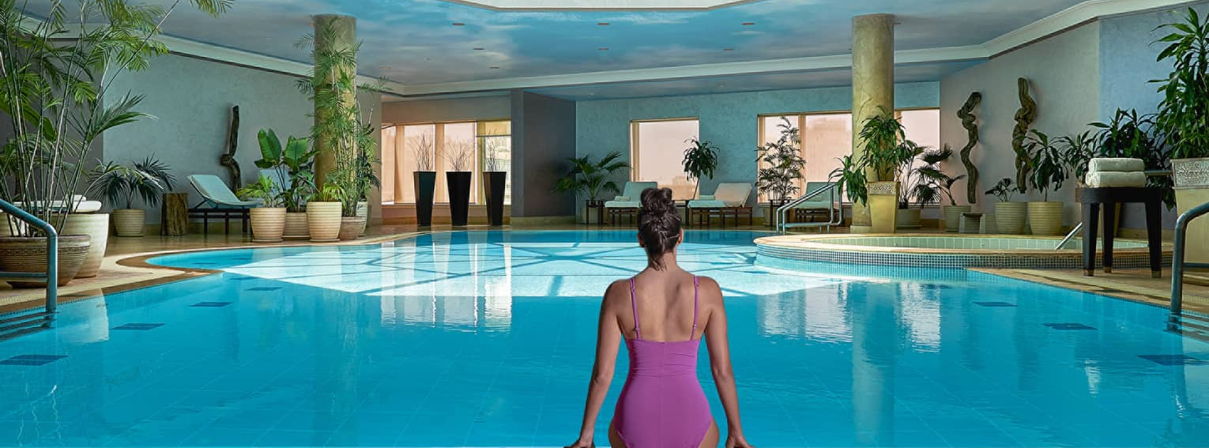

Slide 48
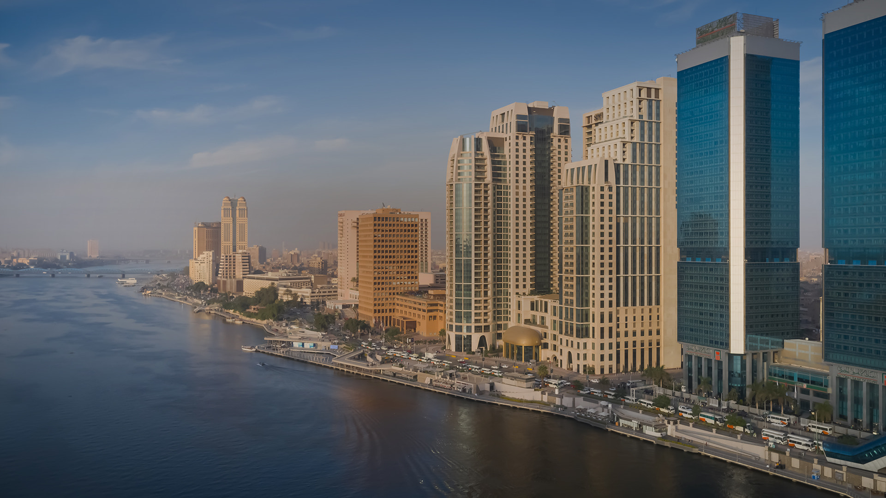
St. Regis Cairo

Slide 49
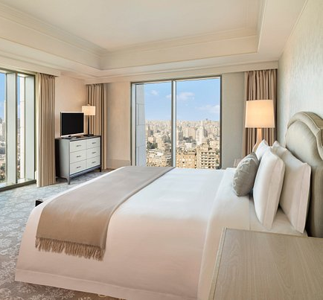
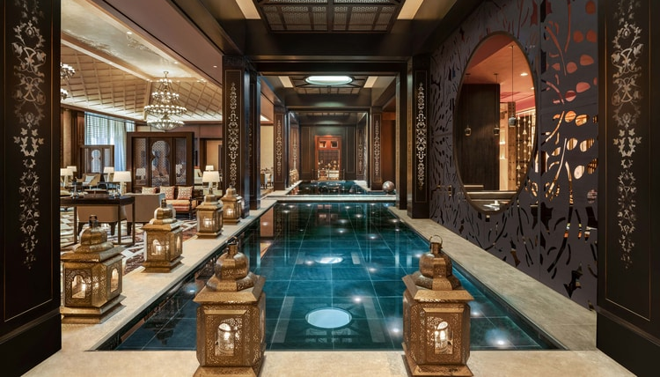
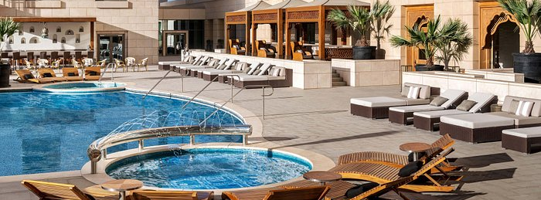

Slide 50
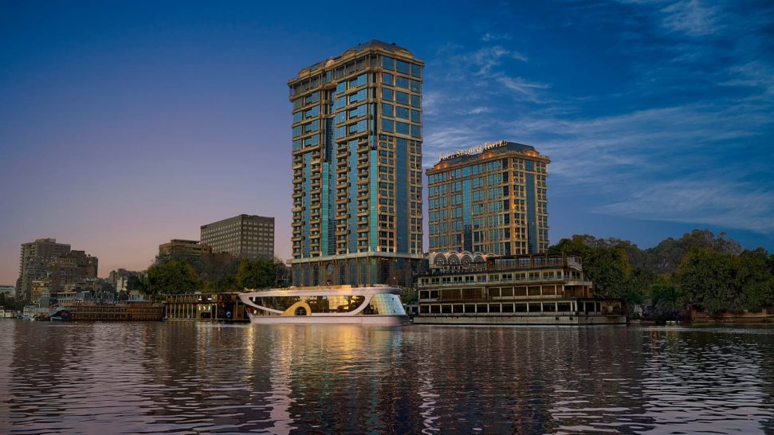
Four Seasons at First Residence

Slide 51
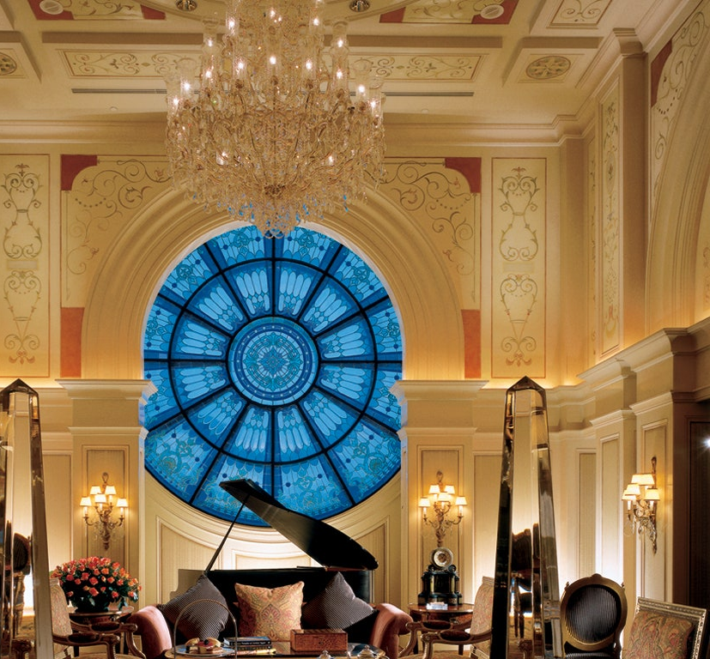
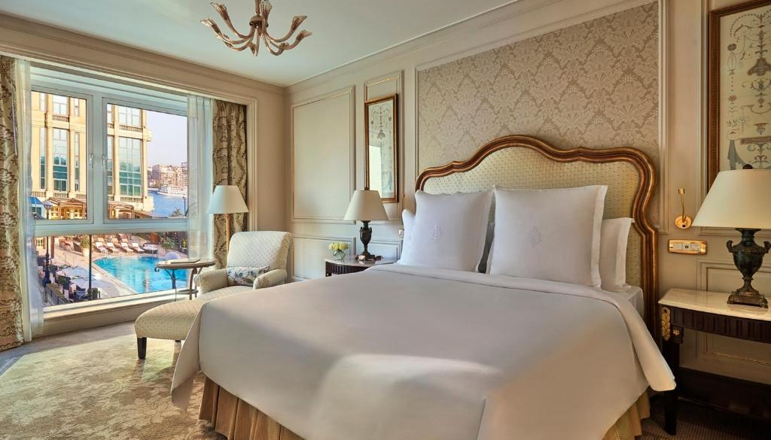
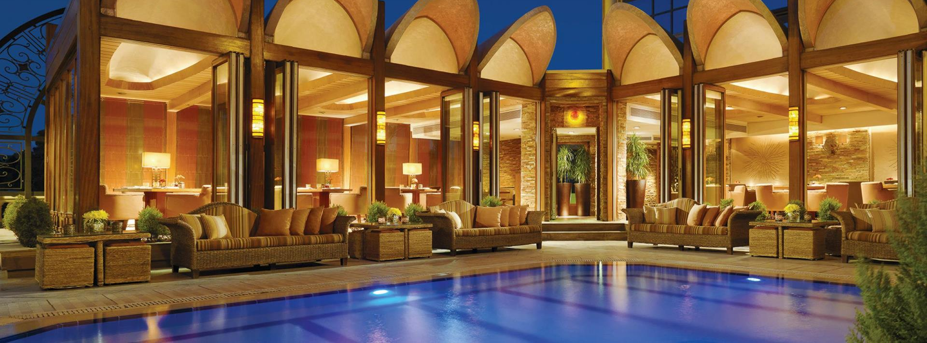

Slide 52
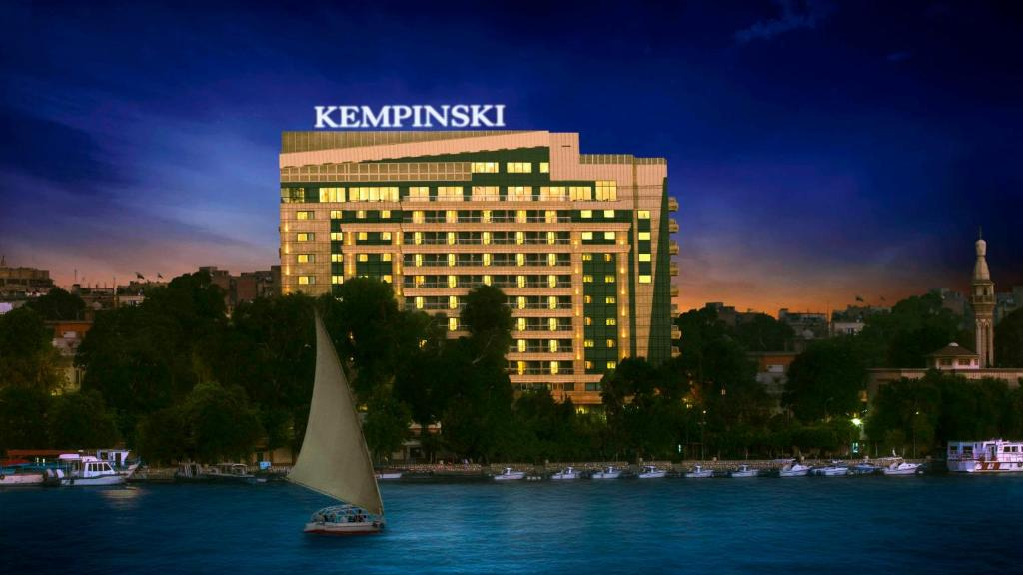
kempinski Nile

Slide 53
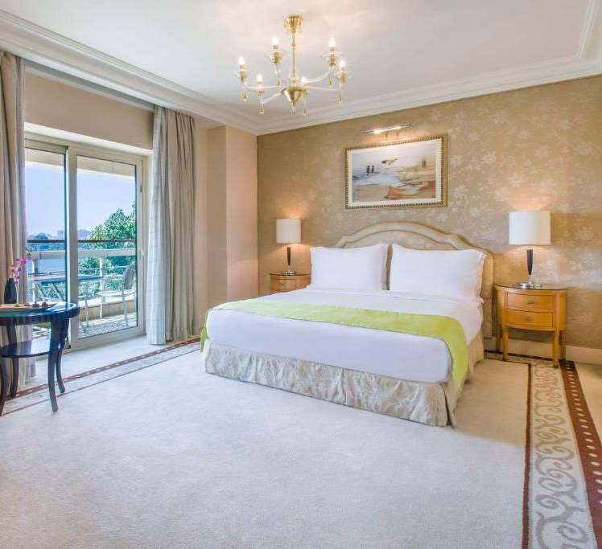



Slide 54

Steigenberger Tahrir

Slide 55




Slide 56

Boutique Hotels

Slide 57

Al Moudira

Slide 58




Slide 59

Lazib Inn

Slide 60




Slide 61

Historic Hotels

Slide 62

Sofitel Legend Old Cataract

Slide 63




Slide 64

Red Sea Resorts

Slide 65

Four Seasons at Sharm El Sheikh

Slide 66




Slide 67

Oberoi Sahl Hasheesh

Slide 68




Slide 69

Cruising the Nile

Slide 70

Oberoi Cruises

Slide 71



Slide 72

Sanctuary Cruises

Slide 73




Slide 74

M/S Historia

Slide 75




Slide 76

Luxury Dahabiya Yachts

Slide 77

Kazazian

Slide 78





Slide 79

Seba

Slide 80




Slide 81

Arax

Slide 82




Slide 83
Aqua

Slide 84




Slide 85

The Legendary Nile Canopus

Slide 86




Slide 87


Slide 88

Jordan

Slide 89

Dubai

Slide 90


